Slide 1

An Evolution of Visualization

Slide 2
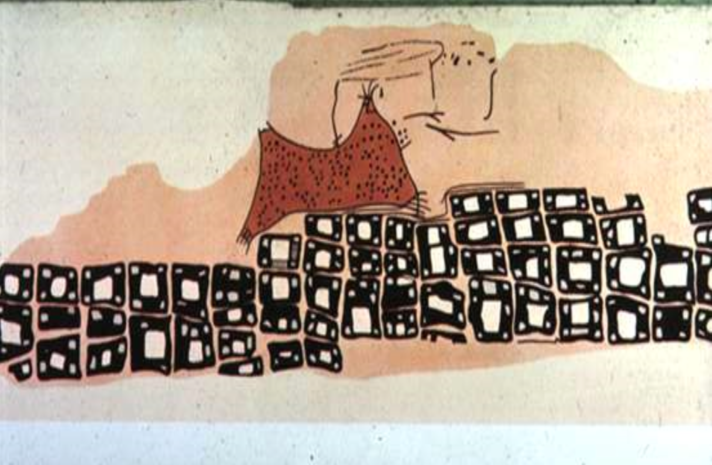
The first data viz!
Notes:
~6200 BC Town Map of Catal Hyük, Konya Plain, Turkey
From Heer

Slide 3
Playfair
“Golden era” of modern graphics
Notes:
traditionally, computed statistics (by hand) are transformed into hand drawn displays
here, a mental model of the data is encoded by Playfair that takes compiled government data
and plots it visually to make it more understandable
René Descartes inspired the cartesian coordinates

Slide 4
Notes:
the tools are recording, computing, sketching by hand, and engraving into templates for print!

Slide 5
Notes:
or, depending on the medium, painting for your particular audience

Slide 6
Notes:
minitab!

Slide 7
Notes:
general purpose scientific plotting packages

Slide 8
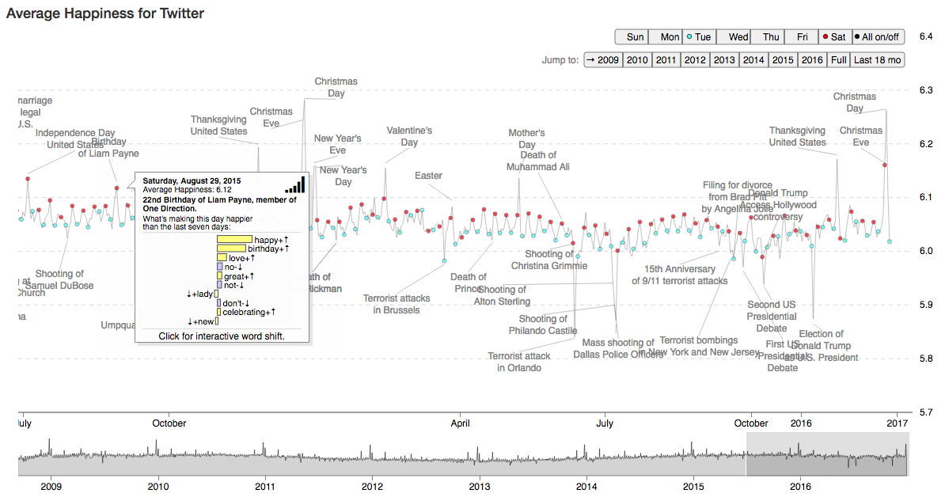
Notes:
online, interactive vector graphics!

Slide 9
Modern tools of the trade
Microsoft Excel
Adobe Illustrator
Tableau
R’s ggplot, Python’s matplotlib
Plotly
D3

Slide 10
Tradeoffs
Scriptable
Speed of iteration
Customizability
Support vector graphics
Interactive
Handle big data
Lines of code needed

Slide 11
Changing frameworks
Engraving, Sketching/painting

Slide 12
Changing frameworks
Engraving, Sketching/painting
Rendered pixel-based graphic (rasters)
(PNG, JPG, BITMAP)

Slide 13
Changing frameworks
Engraving, Sketching/painting
Rendered pixel-based graphic (rasters)
(PNG, JPG, BITMAP)
Vector graphics (PDF, SVG, AI)

Slide 14
Changing frameworks
Engraving, Sketching/painting
Rendered pixel-based graphic (rasters)
(PNG, JPG, BITMAP)
Vector graphics (PDF, SVG, AI)
Interactive (QTK, Web browser)

Slide 15
Visualization backend summary
Paper
Ascii
QTK
PNG
SVG
PDF
WebGL

Slide 16
Rasters vs Vectors
File size
(Many points)
Notes:
Rasters scale O(1), vectors scale O(n)
Keynote doesn’t accept SVG

Slide 17
Rasters vs Vectors
File size
(Many points)
Resizing
Notes:
Rasters scale O(1), vectors scale O(n)
Keynote doesn’t accept SVG

Slide 18
Rasters vs Vectors
File size
(Many points)
Resizing
Portability
Notes:
Rasters scale O(1), vectors scale O(n)
Keynote doesn’t accept SVG

Slide 19
Powering interactivity
Operating system specific libraries

Slide 20
Powering interactivity
Operating system specific libraries
Web browsers

Slide 21
Grammar of visualization
Notes:
plt.plot(time, sales) … plt.scatter(sales, profit)
plt.plot(time, sales, profit)

Slide 22
Software implies the model
Tableau/excel: choose a chart
Illustrator: layout and alignment
Matplotlib/ggplot: plot() for time series
D3: data bound to visual elements

Slide 23
Grammar of visualization
plt.plot(x, y)
qplot(x, y)
Notes:
plt.plot(time, sales) … plt.scatter(sales, profit)
plt.plot(time, sales, profit)

Slide 24
Grammar of visualization
plt.plot(time, sales)
qplot(time, sales)
Notes:
plt.plot(time, sales) … plt.scatter(sales, profit)
plt.plot(time, sales, profit)

Slide 25
Grammar of visualization
plt.plot(time, sales, profit)
Notes:
plt.plot(time, sales) … plt.scatter(sales, profit)
plt.plot(time, sales, profit)

Slide 26
Grammar of visualization
plt.scatter(sales, profit)
Notes:
plt.plot(time, sales) … plt.scatter(sales, profit)
plt.plot(time, sales, profit)

Slide 27
Grammar of visualization

Slide 28
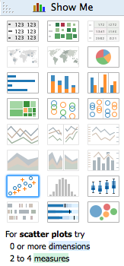
Grammar of visualization

Slide 29
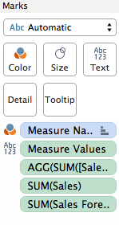
Grammar of visualization

Slide 30
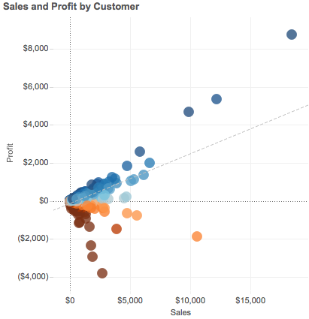
Grammar of visualization

Slide 31
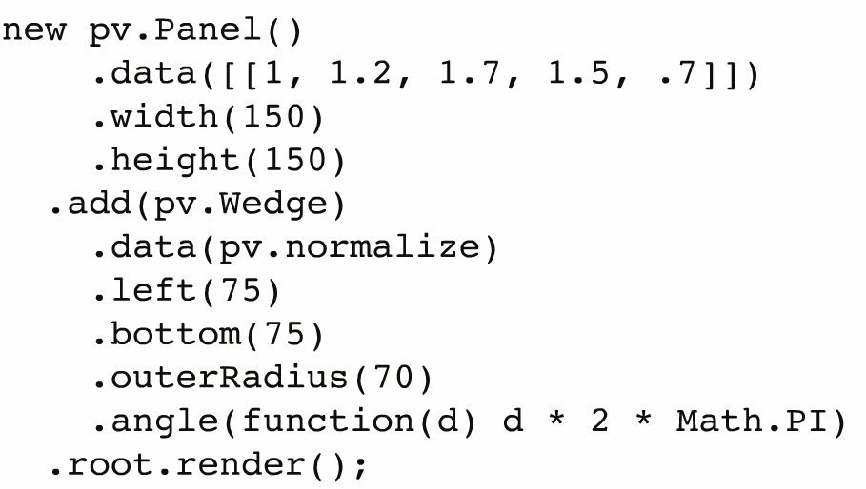
Grammar of visualization
Notes:
protovis

Slide 32
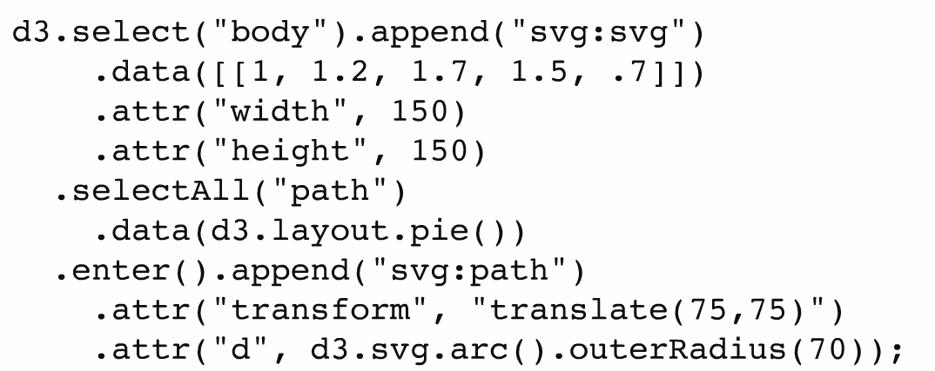
Grammar of visualization
Notes:
and now, d3

Slide 33


